Slide 1
Movie Trailer Views Prediction
By: Emily Spector, MODELS- Linear REGRESSION,
ANN, SUPPORT VECTOR MACHINE
Jonathan Busch, MODELS- KNN, DECISION TREE,
RANDOM FOREST

Slide 2
Variables in Dataset
Trailer Views
Marketing Expense
Production Expense
Budget
Movie Length
Lead Actor Rating
Lead Actress Rating
Director Rating
Producer Rating
Twitter Hashtags
Average Age Actors
X3D Available: Whether the X3D option was available at theatres
Genre

Slide 3
Variable Selection
Dependent Variable:
Trailer Views
Independent Variables:
Marketing Expense
Production Expense
Budget
Movie Length
Lead Actor Rating
Genre
The variables Lead Actress Rating, Director_Rating, Producer_Rating, Twitter_Hashtags, Average Age Actors, X3D_Available were removed either for too high correlation with another predictor or next to no correlation with the dependent variable.
There is potential for further analysis with factor analysis, which could collapse the columns involving ratings into one singular factor, since they are all highly correlated with one another.

Slide 4
Normalization and Data Partitioning
Split the 'Genre' column into dummy variables with the first dummy "action" removed
Partitioned the data into train and valid sets with a set seed to ensure that results stayed the same between each run of the code
Normalized the remaining numeric variables with the preProcess function
Utilized Normalized Data for every model
Trailer Views ~ Marketing Expense+Production Expense+Budget+Movie Length+Lead Actor Rating+Genre Comedy+Genre Drama+Genre Thriller

Slide 5
KNN
K | RMSE
9 | 0.1366
10 | 0.1358
11 | 0.1344
12 | 0.1358
13 | 0.1352
14 | 0.1355
15 | 0.1355
16 | 0.1348
17 | 0.1358
Total number of observations was 506
We wanted to include number around 22
Tested K 1 through 45
Best K was 13
RMSE of 0.135

Slide 6
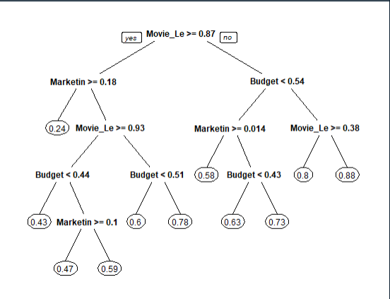
Decision Tree
Single Tree for Prediction
RMSE of 0.137
Random Forest
Significantly more accurate than the single tree prediction, with an RMSE of 0.121

Slide 7
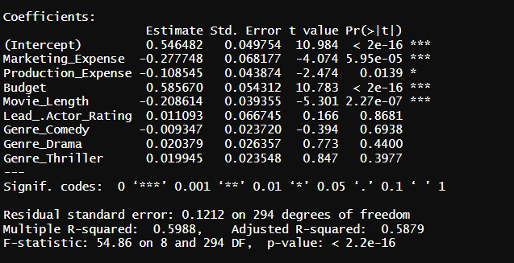
Linear Regression
Significant Variables were Marketing Expense, Production Expense, Budget, and Movie Length
RMSE of 0.123
Adjusted R Squared of 0.5879
Marketing/Production Expenses and Movie Length had negative coefficients while Budget had a large positive coefficient

Slide 8
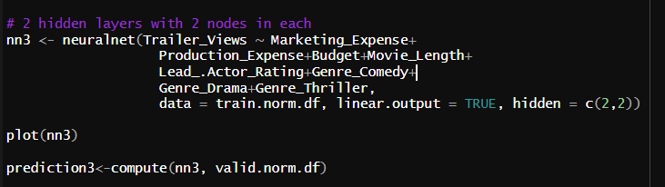
ANN
ANN 2 Hidden Nodes One Layer RMSE of 0.120
ANN 5 Hidden Nodes One Layer RMSE of 0.134
ANN 2 Hidden Nodes Two Layer RMSE of 0.132
Of the Neural Networks ANN 2 Hidden Nodes One Layer turned out to be the best model
This is also the model with the least chances of overfitting as it has the least nodes

Slide 9
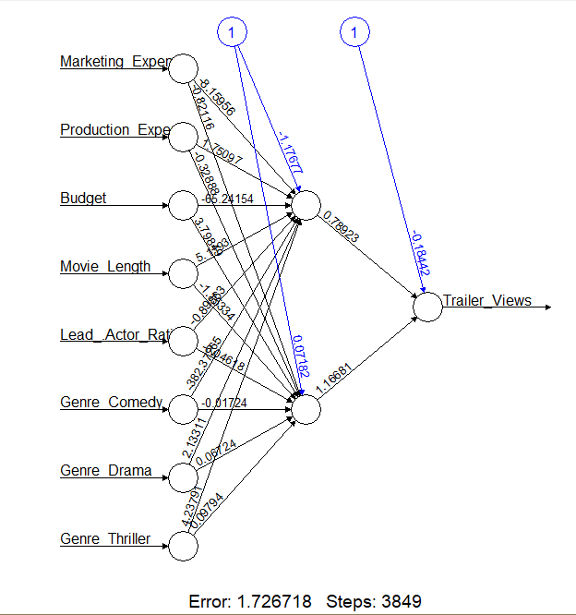
ANN 2 Hidden Nodes One Layer

Slide 10
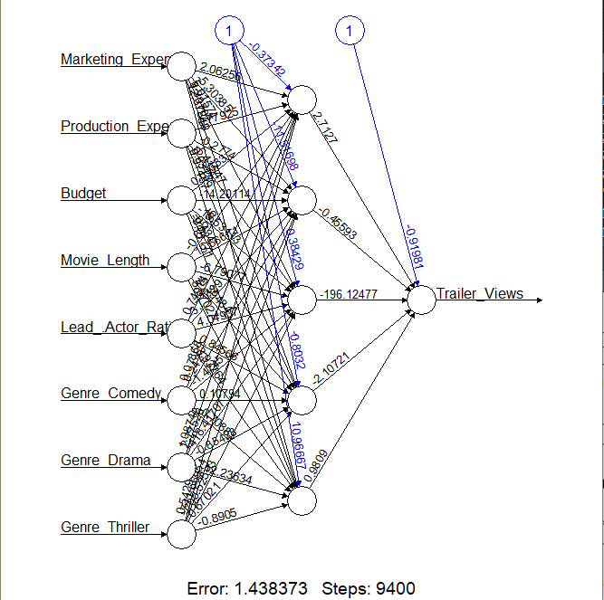
ANN 5 Hidden Nodes One Layer

Slide 11
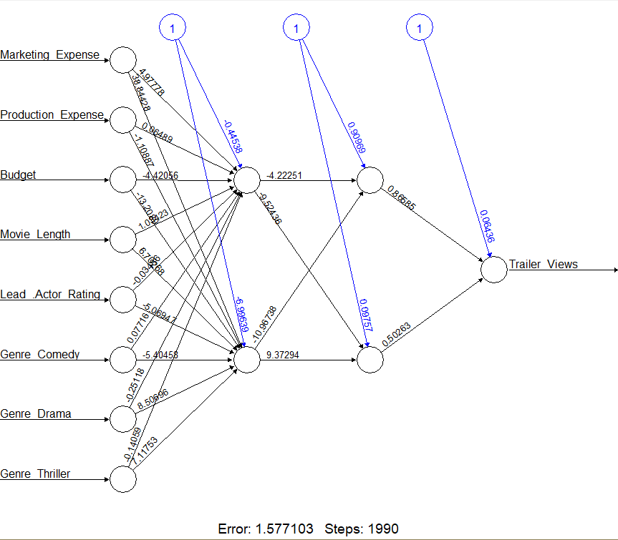
ANN 2 Hidden Nodes TWO Layers
s

Slide 12
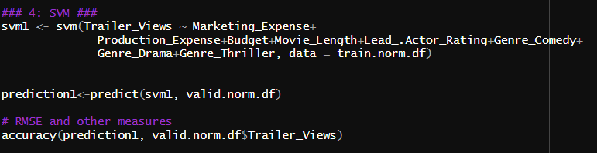
Support Vector Regression (SVR)
RMSE of 0.127
Dataset was 506 observations
This means that SVR may perform better than the more complex ANN given the relatively smaller size of our dataset

Slide 13
RMSE of all Models
Model | RMSE
KNN | 0.135
Decision Tree | 0.137
Random Forest | 0.121
Linear Regression | 0.123
ANN 2 Hidden Nodes One Layer | 0.120
ANN 5 Hidden Nodes One Layer | 0.134
ANN 2 Hidden Nodes Two Layers | 0.132
Support Vector Machine | 0.127

Slide 14
Conclusion
The ANN model with 2 nodes and one hidden layer had the highest accuracy of all the models we developed; it is the model we would choose to predict the views of a movie trailer, despite its risk of over fitting, which is something to keep in mind.
Linear Regression and Random Forest models were quite similar in accuracy to ANN, but different RMSE values and preferences for a different model may emerge based on the random partitioning of test and validation data.
The models were initially constructed using normalized test data. However, an oversight led to validation of the model being performed using un-normalized validation data, resulting in RMSE values going up to 400,000.
Room for future analysis, specifically focusing more on dimension reduction and hidden variables

